Slide 1
The Wronskian function: linear dependence and independence
Dr. Aruna Kulkarni

Slide 2
In mathematics, the Wronskian is a determinant introduced by Jozef Hoene-Wronskian. It is used in the study of differential equations. It shows linear independence in a set of solutions.

Slide 3
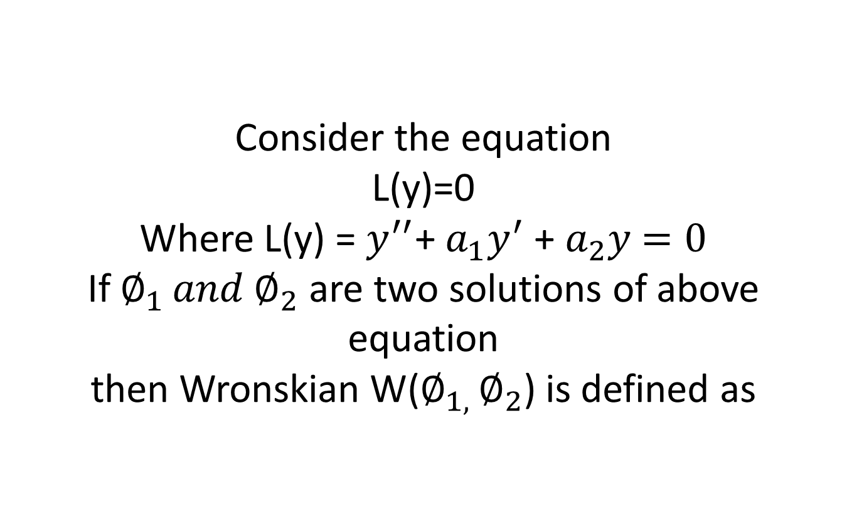
Consider the equation L(y)=0 Where L(y) = $y^{′′}$+ $a_{1}y^{′}$ + $a_{2}y$ $=0$ If $∅_{1 }{and ∅}_{2}$ are two solutions of above equation then Wronskian W($∅_{1, }∅_{2}$) is defined as

Slide 4
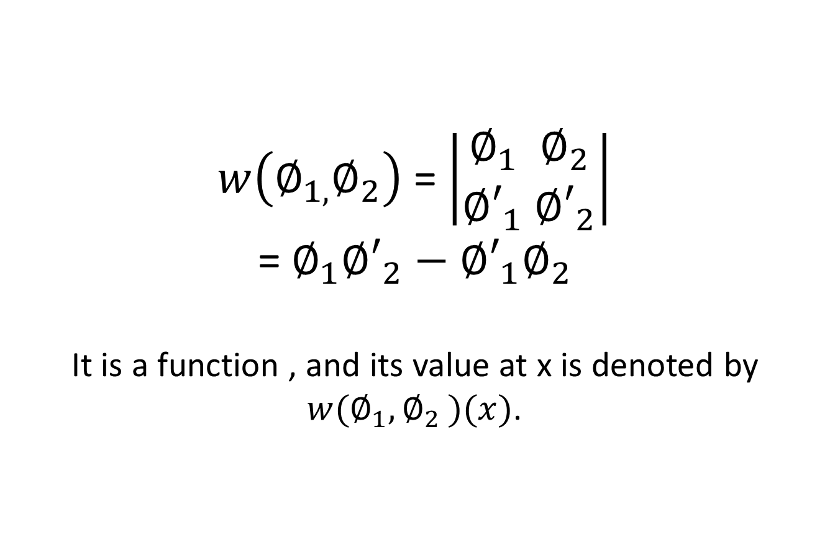
$w\left(∅_{1,}∅_{2}\right)$ = $\left|\begin{aligned}∅_{1}{ ∅}_{2} \\ {∅′}_{1}{ ∅′}_{2}\end{aligned}\right|$ = $∅_{1}{∅′}_{2}−{∅′}_{1}∅_{2}$ It is a function , and its value at x is denoted by $w(∅_{1}{,∅}_{2})(x)$.

Slide 5
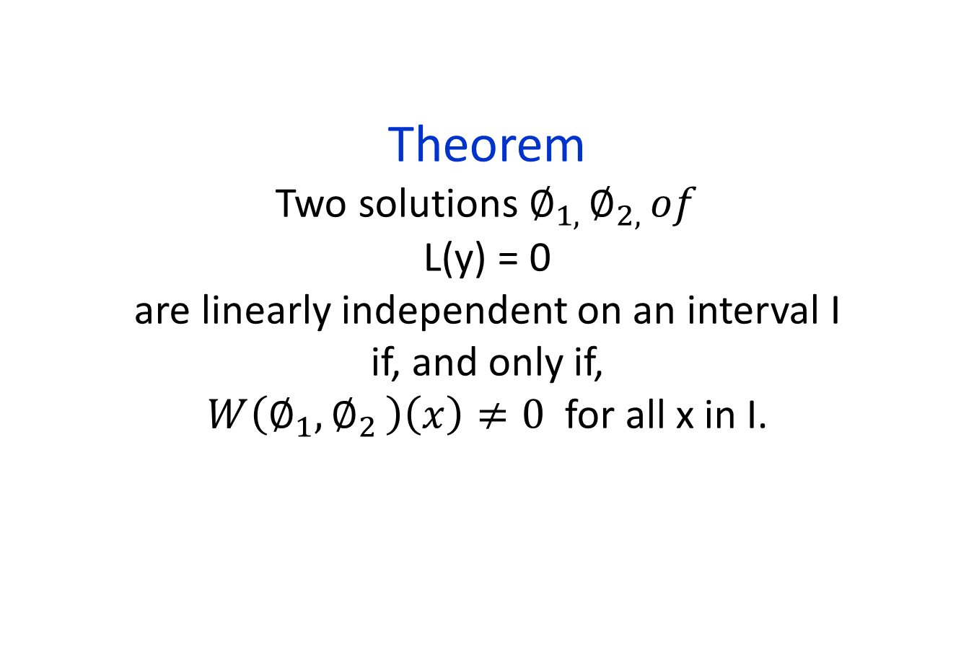
Theorem Two solutions $∅_{1, }∅_{2, }of$ L(y) = 0 are linearly independent on an interval I if, and only if, $W\left(∅_{1}{,∅}_{2}\right)\left(x\right)≠0$ for all x in I.

Slide 6
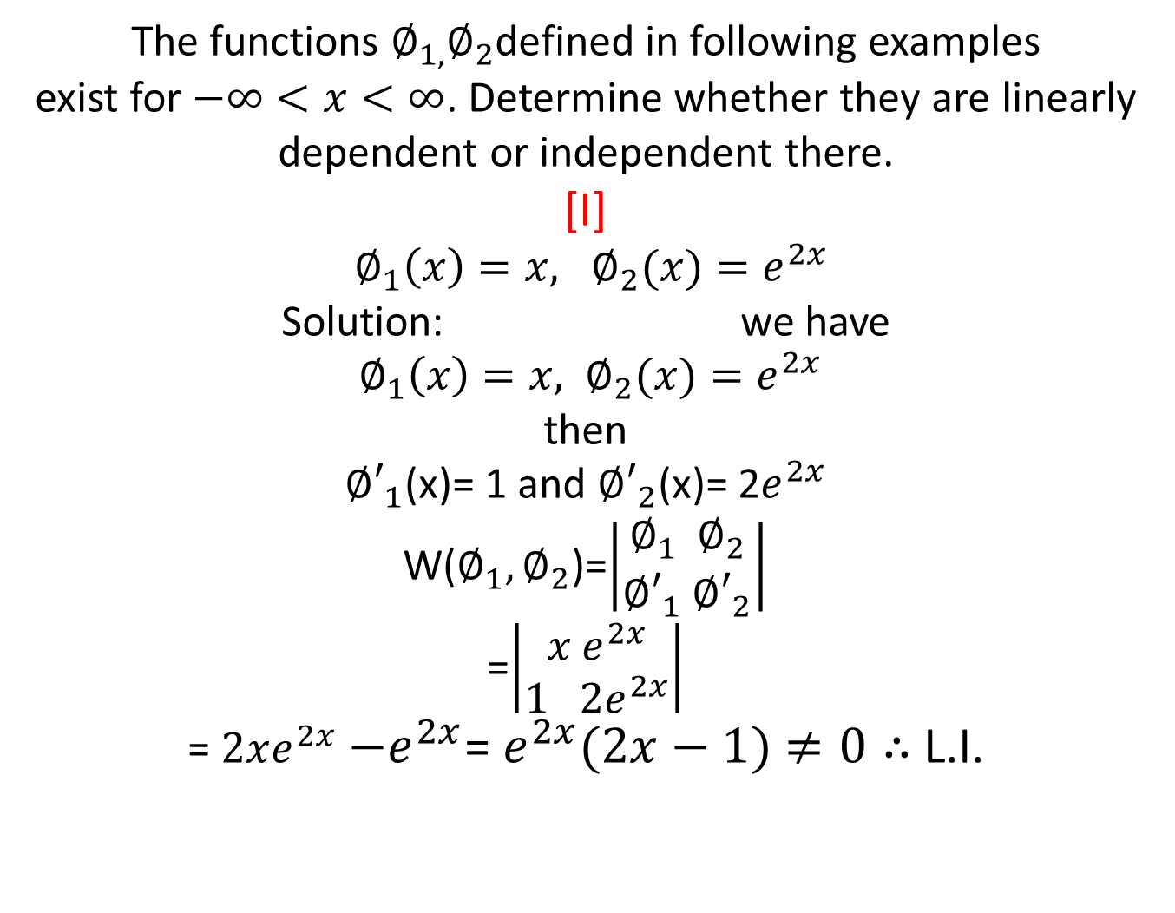
The functions $∅_{1,}∅_{2}$defined in following examples exist for $−∞<x<∞$. Determine whether they are linearly dependent or independent there. [I] $∅_{1}{\left(x\right)=x, ∅}_{2}(x)=e^{2x}$ Solution: we have $∅_{1}{\left(x\right)=x, ∅}_{2}(x)=e^{2x}$ then ${∅′}_{1}$(x)= 1 and ${∅′}_{2}$(x)= 2$e^{2x}$ W($∅_{1}{,∅}_{2}$)=$\left|\begin{aligned}∅_{1}{ ∅}_{2} \\ {∅′}_{1}{ ∅′}_{2}\end{aligned}\right|$ =$\left|\begin{aligned}x e^{2x} \\ 1 2e^{2x}\end{aligned}\right|$ = $2xe^{2x}$ $−e^{2x}$= $e^{2x}(2x−1)$ $≠0∴$ L.I.

Slide 7
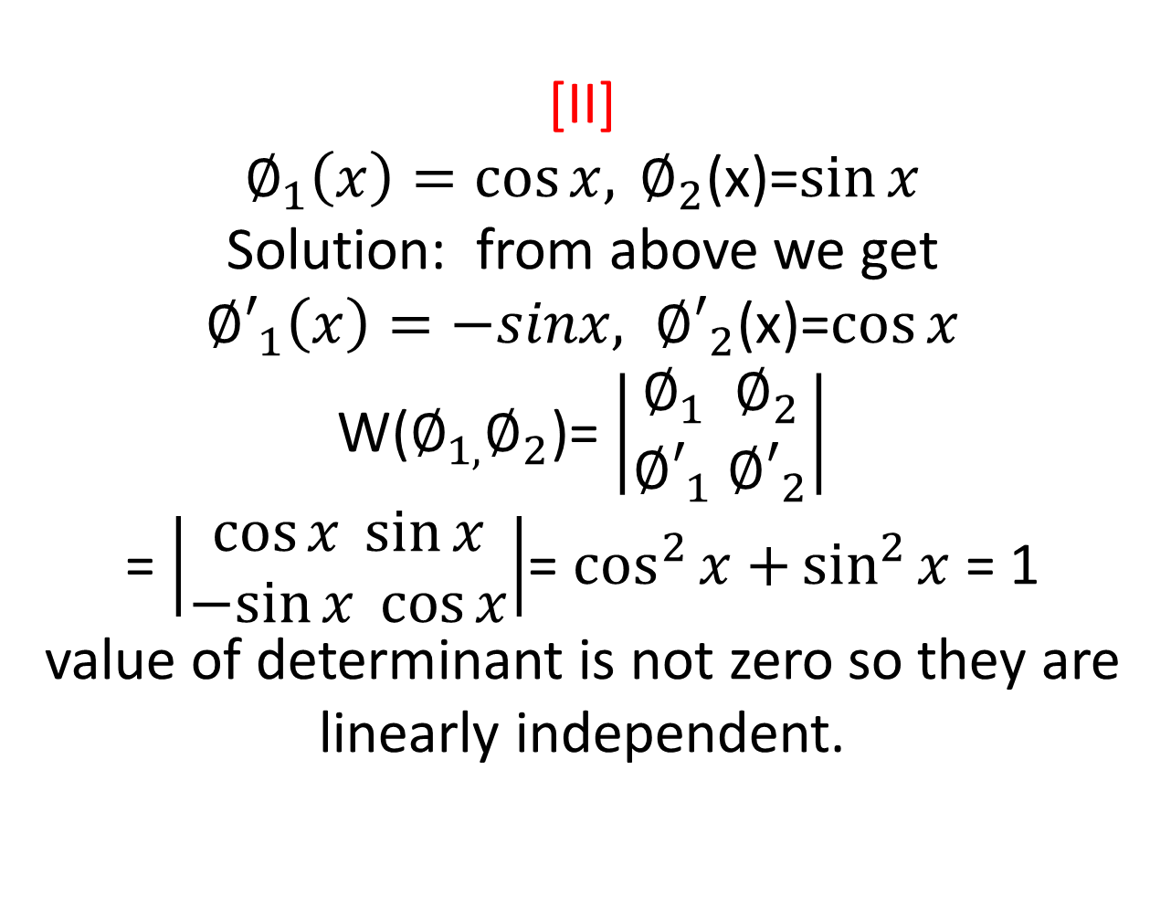
[II] $∅_{1}{\left(x\right)=\cos{x, }∅}_{2}$(x)=$\sin{x}$ Solution: from above we get ${∅′}_{1}{\left(x\right)=−sinx, ∅′}_{2}$(x)=$\cos{x}$ W($∅_{1,}∅_{2}$)= $\left|\begin{aligned}∅_{1}{ ∅}_{2} \\ {∅′}_{1}{ ∅′}_{2}\end{aligned}\right|$ = $\left|\begin{aligned}\cos{x }\sin{x} \\ −sin{x}\cos{x}\end{aligned}\right|$= $\cos^{2}{x+}\sin^{2}{x}$ = 1 value of determinant is not zero so they are linearly independent.

Slide 8
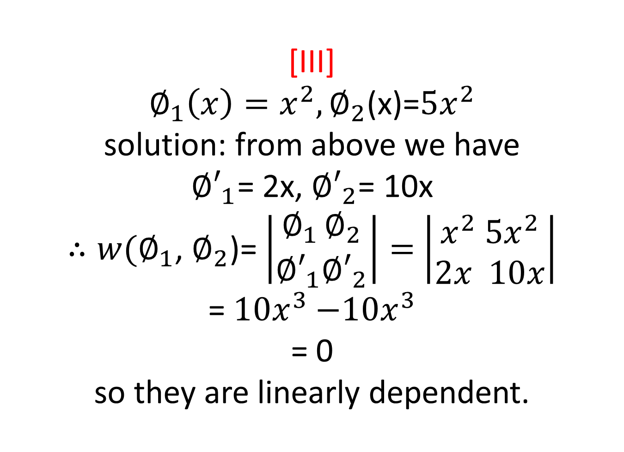
[III] $∅_{1}{\left(x\right)=x^{2},∅}_{2}$(x)=${5x}^{2}$ solution: from above we have ${∅′}_{1}$= 2x, ${∅′}_{2}$= 10x $∴w(∅_{1}$, $∅_{2}$)= $\left|\begin{aligned}∅_{1 }∅_{2} \\ {∅′}_{1}{∅′}_{2}\end{aligned}\right|=$ $\left|\begin{aligned}x^{2}{ 5x}^{2} \\ 2x 10x\end{aligned}\right|$ = ${10x}^{3}{−10x}^{3}$ = 0 so they are linearly dependent.

Slide 9
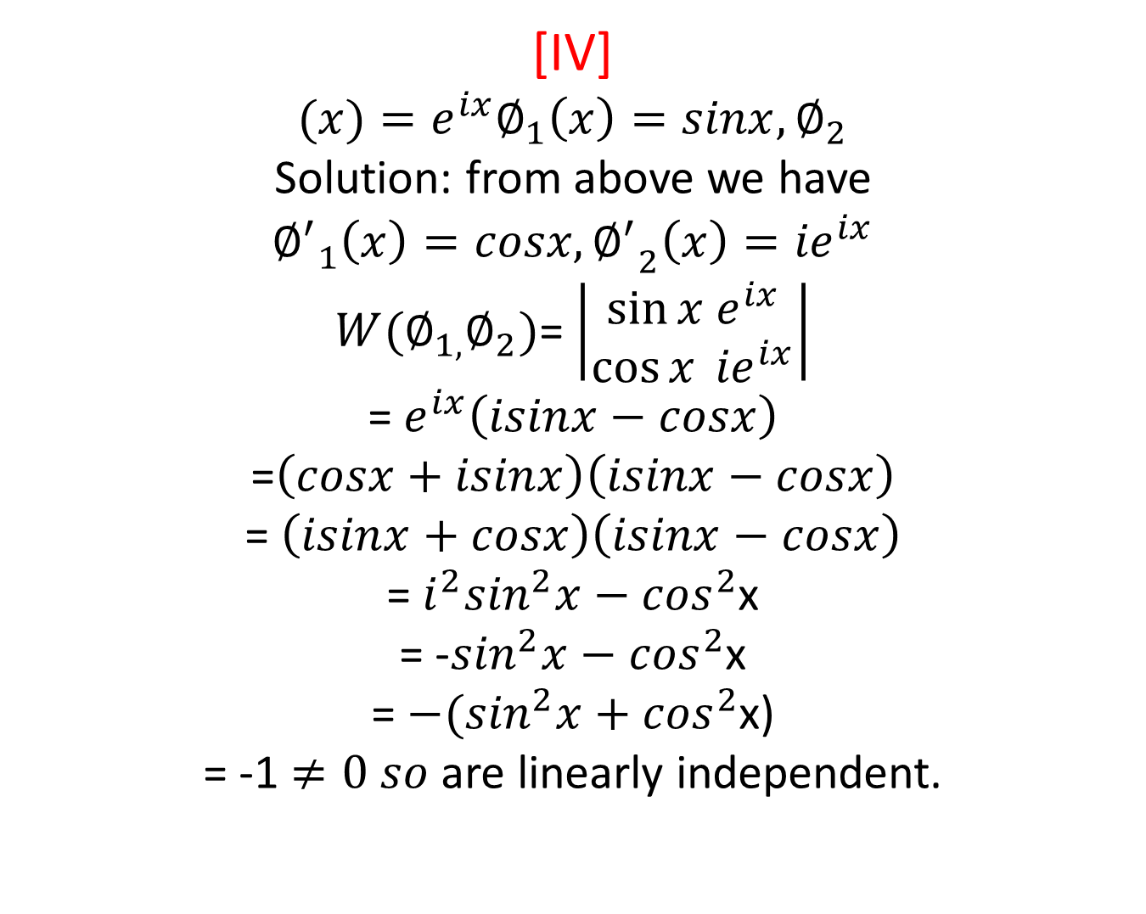
[IV] $$(x)=e^{ix}∅_{1}{\left(x\right)=sinx, ∅}_{2}$$ Solution: from above we have $${∅^{′}}_{1}{\left(x\right)=cosx, ∅^{′}}_{2}\left(x\right)={ie}^{ix}$$ $W(∅_{1,}∅_{2})$= $\left|\begin{aligned}\sin{x}{ e}^{ix} \\ \cos{x} {ie}^{ix}\end{aligned}\right|$ = $e^{ix}\left(isinx−cosx\right)$ =$\left(cosx+isinx\right)\left(isinx−cosx\right)$ = $\left(isinx+cosx\right)\left(isinx−cosx\right)$ = $i^{2}\sin^{2}x−\cos^{2}$x = -$\sin^{2}x−\cos^{2}$x = $−(\sin^{2}x+\cos^{2}$x) = -1 $≠0 so$are linearly independent.

Slide 10

Assignment $∅_{1}{\left(x\right)=cosx, ∅}_{2}(x)$= $3(e^{ix}+e^{−ix})$. Thank You.

